Slide 1
The Sentence
Chapter 10
Pg. 323

Slide 2
The Sentence
Sentence:
A word group that contains a subject and a verb and that expresses a complete thought.
Begins with a capital letter and ends with a mark of punctuation.
Fragment:
Does not contain both a subject and a verb.
Does not express a complete thought.

Slide 3
Examples
Sentence:
Sean was chosen captain of the soccer team.
I love candy and ice cream.
Stop! Run! (understood “you”)
Fragment:
Was a well-known football player.
A butterfly with bright wings.
Even though she had worked a long time.

Slide 4
Identify as Sentence or Fragment
One of the best-known women in American history Sacagawea.
A member of the Lemhi band of the Shoshone.
She is famous for her role as interpreter for the Lewis and Clark expedition.
Which was seeking the Northwest Passage.
In 1800, the Lemhis had encountered a war party of the Hidatsa.

Slide 5
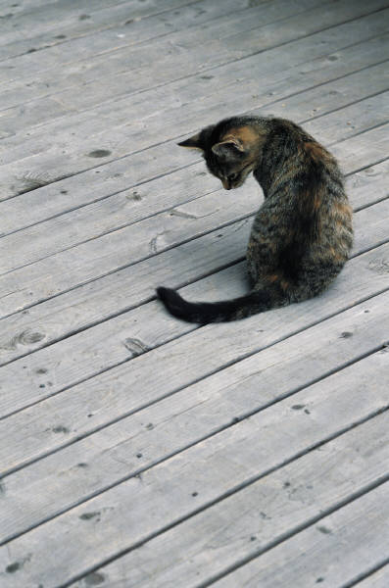
Subject
Tells whom or what the sentence is about.
Aunt Louise found a beautiful antique lamp at the garage sale.
The kitten with the white paws is called boots.
How surprised we were!

Slide 6
Complete Subject
Consists of all the words that tell whom or what the sentence is about.
This includes adjectives!!
Laughing and running down the street were two small boys.
A sealed envelope rested near the edge of the desk.
Are Dalmatians very good watchdogs?
Can horses and cattle swim?

Slide 7
Identify the Complete Subject
People throughout Latin America enjoy going out to a ballgame.
The all-American sport of baseball has been very popular for a long time.
In fact, fans in countries such as Cuba, Panama, and Venezuela go wild over the game.
As a result, the Caribbean Baseball Leagues were formed more than fifty years ago.

Slide 8
Identify the Complete Subject
People throughout Latin America enjoy going out to a ballgame.
The all-American sport of baseball has been very popular for a long time.
In fact, fans in countries such as Cuba, Panama, and Venezuela go wild over the game.
As a result, the Caribbean Baseball Leagues were formed more than fifty years ago.

Slide 9
Simple Subject
The main word or word group that tells whom or what the sentence is about.
It is NEVER in a prepositional phrase.
Leave out adjectives.
There can be compound simple subjects.
The dangerous trip over the mountain took four days.
Someone in this room is about to get a big surprise.
Pacing back and forth in the cage was a hungry tiger.
A bus stop is at the end of our street.

Slide 10
Identify the Simple Subject
People throughout Latin America enjoy going out to a ballgame.
The all-American sport of baseball has been very popular for a long time.
In fact, fans in countries such as Cuba, Panama, and Venezuela go wild over the game.
As a result, the Caribbean Baseball Leagues were formed more than fifty years ago.

Slide 11
Predicate
Tells something about the subject.
Marco’s brother delivers pizza.
Under a large bush sat the tiny rabbit
Does this copier staple and fold documents.

Slide 12
Complete Predicate
Consists of a verb and all the words that describe the verb and complete its meaning.
I walked on the sidewalk.
The petite puppy walked slowly to the food bowl.
On the tiny branch perched a chickadee.

Slide 13
Identify the Complete Predicate
A ton and a half of groceries may seem like a big order for a family of five.
Such a big order is possible in the village of Pang.
This small village is located near the Arctic Circle.
Once a year the people of Pang receive their groceries.
A supply ship can visit Pang only during a short time each summer.

Slide 14
Identify the Complete Predicate
A ton and a half of groceries may seem like a big order for a family of five.
Such a big order is possible in the village of Pang.
This small village is located near the Arctic Circle.
Once a year the people of Pang receive their groceries.
A supply ship can visit Pang only during a short time each summer.

Slide 15
Simple Predicate
A verb that is the main word or word group that tells something about the subject.
Many birds fly south before winter.
These books are available in the media center.
Our English class is reading the novel Frankenstein.
The musicians have been rehearsing since noon.

Slide 16
Identify the Simple Predicate
A ton and a half of groceries may seem like a big order for a family of five.
Such a big order is possible in the village of Pang.
This small village is located near the Arctic Circle.
Once a year the people of Pang receive their groceries.
A supply ship can visit Pang only during a short time each summer.

Slide 17
Compound Subject
Consists of two or more connected subjects that have the same verb.
Keshia and Todd worked a jigsaw puzzle.
Either Carmen or Ernesto will videotape the ceremony tomorrow.
Among the guest speakers were an astronaut, and engineer, and a journalist.

Slide 18
Identify the Compound Subject
Children and nature are honored with their own festivals in Japan.
Among Japanese nature festivals are the Cherry Blossom Festival and Chrysanthemum Festival.
Fierce dragons and even huge ships fly in the sky during the festivals.

Slide 19
Identify the Compound Subject
Children and nature are honored with their own festivals in Japan.
Among Japanese nature festivals are the Cherry Blossom Festival and Chrysanthemum Festival.
Fierce dragons and even huge ships fly in the sky during the festivals.

Slide 20
Compound Verb
Consists of two or more verbs that have the same subject.
The dog barked and growled at the stranger.
The man was convicted but was later was found innocent of the crime.
Some plants sprout, bloom, and wither quickly.

Slide 21
Identify the Compound Verb
Linda wrote her essay and practiced the piano last night.
Miami is the largest city in southern Florida and has been a popular resort area since the 1920s.
According to Greek mythology, Arachne angered Athena and was turned into a spider.

Slide 22
Identify the Compound Verb
Linda wrote her essay and practiced the piano last night.
Miami is the largest city in southern Florida and has been a popular resort area since the 1920s.
According to Greek mythology, Arachne angered Athena and was turned into a spider.

